Slide 1


Data Lake and Delta Lake
(What is It?)

Slide 2
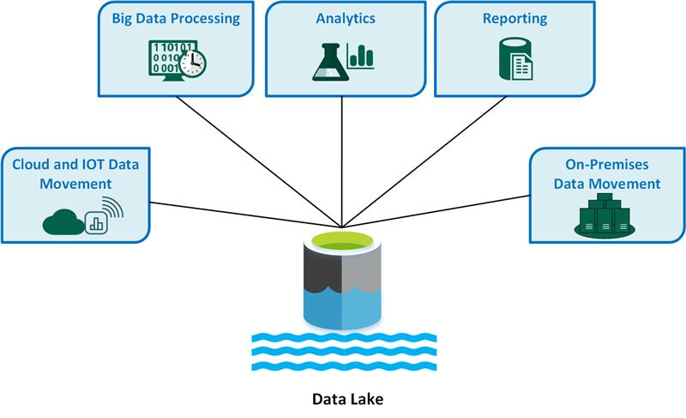
Data becomes your “single source of truth”
Azure Data Lake is a cloud-based service that allows users to store, analyze, and integrate data of any size, shape, and speed. It's designed for big data analytics workloads and can be used for a variety of tasks, including:
Storing and analyzing large files and objects
Debugging and optimizing big data programs
Developing parallel programs
Batch, streaming, and interactive analytics
Data transformation and processing
Unstructured + Structured + Semi-Structured

Slide 3
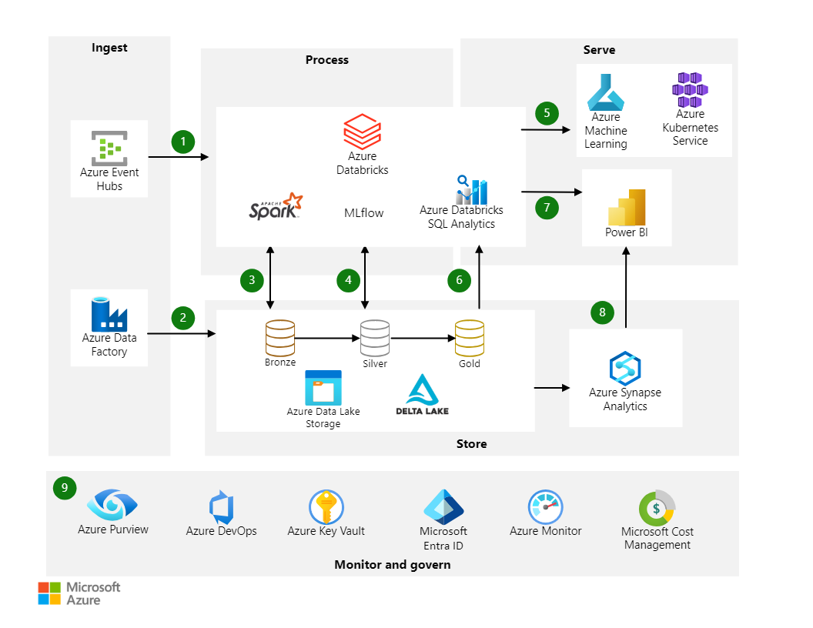
By combining ADLS for storage and Delta Lake for data management, you get a robust and scalable data architecture capable of handling complex data workloads efficiently.
Azure Data Lake Storage (ADLS)
Purpose: ADLS is designed for scalable, high-performance data storage, catering to large datasets that need to be accessed and processed by various analytics and machine learning tools.
Storage: It supports the storage of data in its raw form, allowing you to store structured, semi-structured, and unstructured data.
Integration: ADLS integrates seamlessly with other Azure services, including Azure Databricks, to provide a comprehensive data platform.
Notes:
Azure Data Lake Storage (ADLS)
Purpose: ADLS is designed for scalable, high-performance data storage, catering to large datasets that need to be accessed and processed by various analytics and machine learning tools.
Storage: It supports the storage of data in its raw form, allowing you to store structured, semi-structured, and unstructured data.
Integration: ADLS integrates seamlessly with other Azure services, including Azure Databricks, to provide a comprehensive data platform.
Delta Lake
Purpose: Delta Lake is an open-source storage layer that brings ACID (Atomicity, Consistency, Isolation, Durability) transactions to big data workloads, ensuring data reliability and consistency.
Data Management: It offers features such as versioning, time travel, and schema enforcement, which are crucial for maintaining data integrity in large-scale data processing.
Performance: Delta Lake enhances performance by optimizing data access and queries, making it suitable for both batch and streaming data processing.

Slide 4
By combining ADLS for storage and Delta Lake for data management, you get a robust and scalable data architecture capable of handling complex data workloads efficiently.
Delta Lake
Purpose: Delta Lake is an open-source storage layer that brings ACID (Atomicity, Consistency, Isolation, Durability) transactions to big data workloads, ensuring data reliability and consistency.
Data Management: It offers features such as versioning, time travel, and schema enforcement, which are crucial for maintaining data integrity in large-scale data processing.
Performance: Delta Lake enhances performance by optimizing data access and queries, making it suitable for both batch and streaming data processing.
Notes:
Azure Data Lake Storage (ADLS)
Purpose: ADLS is designed for scalable, high-performance data storage, catering to large datasets that need to be accessed and processed by various analytics and machine learning tools.
Storage: It supports the storage of data in its raw form, allowing you to store structured, semi-structured, and unstructured data.
Integration: ADLS integrates seamlessly with other Azure services, including Azure Databricks, to provide a comprehensive data platform.
Delta Lake
Purpose: Delta Lake is an open-source storage layer that brings ACID (Atomicity, Consistency, Isolation, Durability) transactions to big data workloads, ensuring data reliability and consistency.
Data Management: It offers features such as versioning, time travel, and schema enforcement, which are crucial for maintaining data integrity in large-scale data processing.
Performance: Delta Lake enhances performance by optimizing data access and queries, making it suitable for both batch and streaming data processing.

Slide 5
By combining ADLS for storage and Delta Lake for data management, you get a robust and scalable data architecture capable of handling complex data workloads efficiently.
How They Work Together
Data Ingestion: Raw data ( Structure and Unstructured) is ingested into ADLS, where it can be stored in its native format.
Data Processing: Databricks and other analytics tools can process this data directly from ADLS.
Delta Lake Integration: Delta Lake can be layered on top of ADLS to manage this data more effectively, providing reliability, consistency, and performance improvements.
Advanced Analytics: With Delta Lake, you can perform advanced analytics on your data while ensuring data quality and governance.
ADLS: For scalable, cost-effective storage of raw data.
Delta Lake: For adding reliability, consistency, and performance optimizations
Notes:
Azure Data Lake Storage (ADLS)
Purpose: ADLS is designed for scalable, high-performance data storage, catering to large datasets that need to be accessed and processed by various analytics and machine learning tools.
Storage: It supports the storage of data in its raw form, allowing you to store structured, semi-structured, and unstructured data.
Integration: ADLS integrates seamlessly with other Azure services, including Azure Databricks, to provide a comprehensive data platform.
Delta Lake
Purpose: Delta Lake is an open-source storage layer that brings ACID (Atomicity, Consistency, Isolation, Durability) transactions to big data workloads, ensuring data reliability and consistency.
Data Management: It offers features such as versioning, time travel, and schema enforcement, which are crucial for maintaining data integrity in large-scale data processing.
Performance: Delta Lake enhances performance by optimizing data access and queries, making it suitable for both batch and streaming data processing.

Slide 6
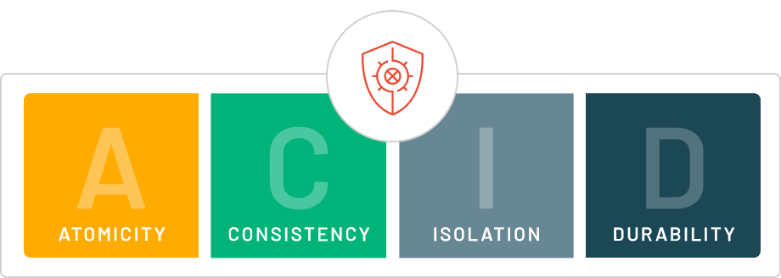
Data becomes your single source of truth
Azure Databricks uses cloud object storage to store all data files and transaction logs. Cloud object storage has high availability and durability.
The transaction log controls commit atomicity. During a transaction, data files are written to the file directory backing the table. When the transaction completes, a new entry is committed to the transaction log that includes the paths to all files written during the transaction.
Azure Databricks uses write serializable isolation by default for all table writes and updates. Snapshot isolation is used for all table reads.
Delta Lake uses optimistic concurrency control to provide transactional guarantees between writes.
Notes:
By adding data warehouse-like management capabilities to data lakes (like ACID transactions and schema enforcement), Delta Lake transforms a simple data lake into a more robust, reliable, and performance-optimized data platform, which is sometimes referred to as a data lakehouse.

